Slide 1
PROJECT C PRESENTATION
Warren Siciliano
Cybersecurity Bootcamp cohort 19-a

Slide 2
EXECUTIVE SUMMARY
As requested by Quickstart, a penetration test was executed on a Production Server and a Webserver connected to a trusted network and in the DMZ to analyze and determine the integrity of the security measures existing on these systems.
While conducting the penetration test, the following issues were found:
Multiple potential vulnerabilities on each of the servers:
We successfully exploited the servers as follows:
Anonymous FTP access to both the Web Server and Production Server via the Very Secure FTP Daemon (VSFTPD) exploit of port 21
Password files were able to be accessed on the Production Server with a potential to be uncovered offline.
We also found multiple unprotected files with system or personal data such as Private server keys, Root keys and Server Certificates
Malicious payloads were able to be inserted into both the Production and Web Servers
Most of these vulnerabilities should be corrected immediately. Several of these are non-critical but should be monitored.

Slide 3
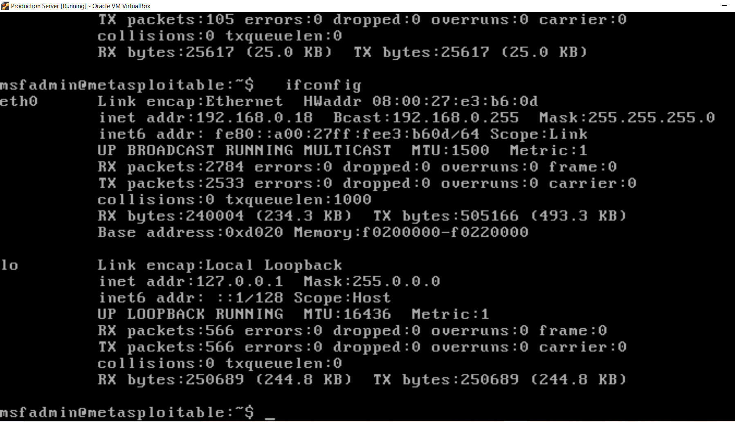
Project task 1 install production server vm into trusted network in virtualbox

Slide 4
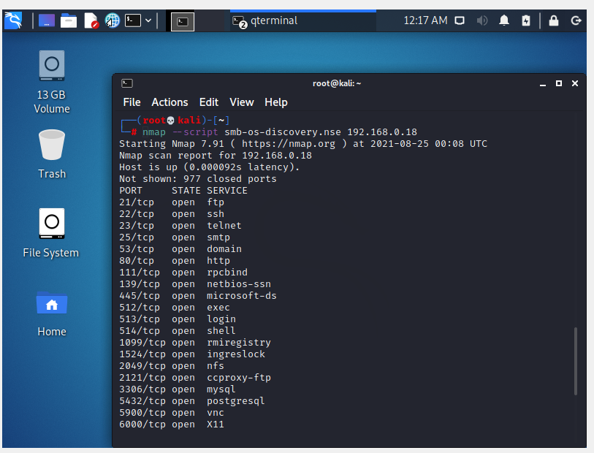
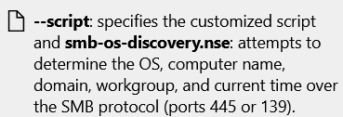
Project C task 2: use tools within kali linux to enumerate possible vulnerabilities on the production server

Slide 5
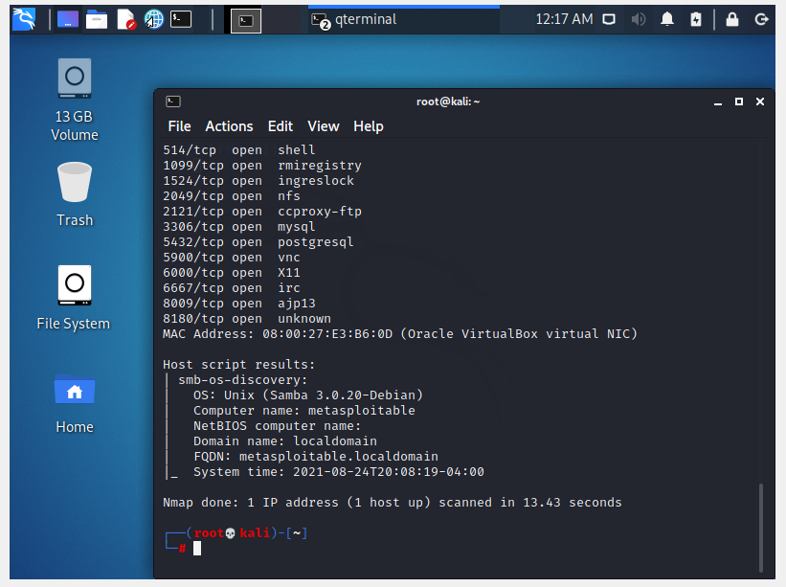
Project C task 2: use tools within kali linux to enumerate possible vulnerabilities on the production server

Slide 6
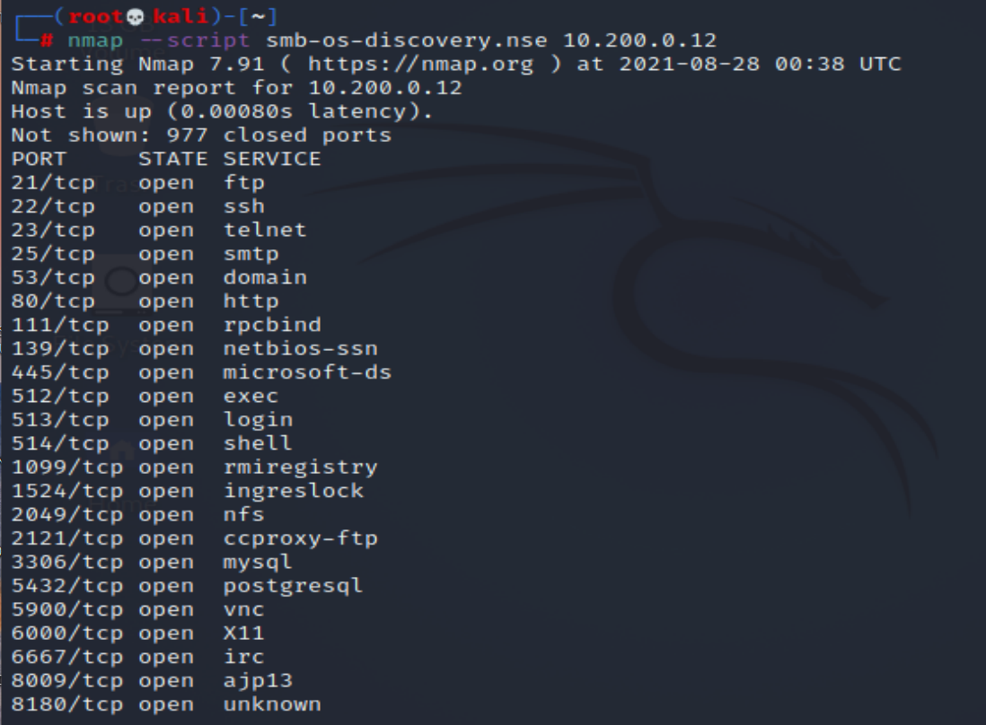
Project C task 3: use tools within kali linux to enumerate possible vulnerabilities on the Web server

Slide 7
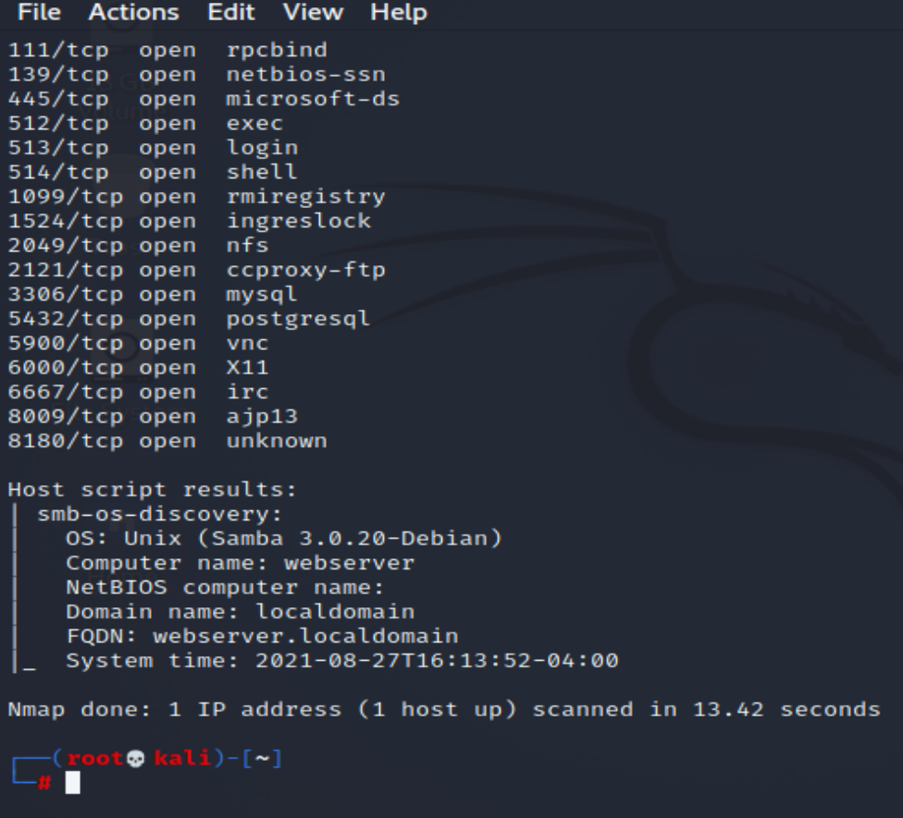
Project C task 3: use tools within kali linux to enumerate possible vulnerabilities on the Web server

Slide 8
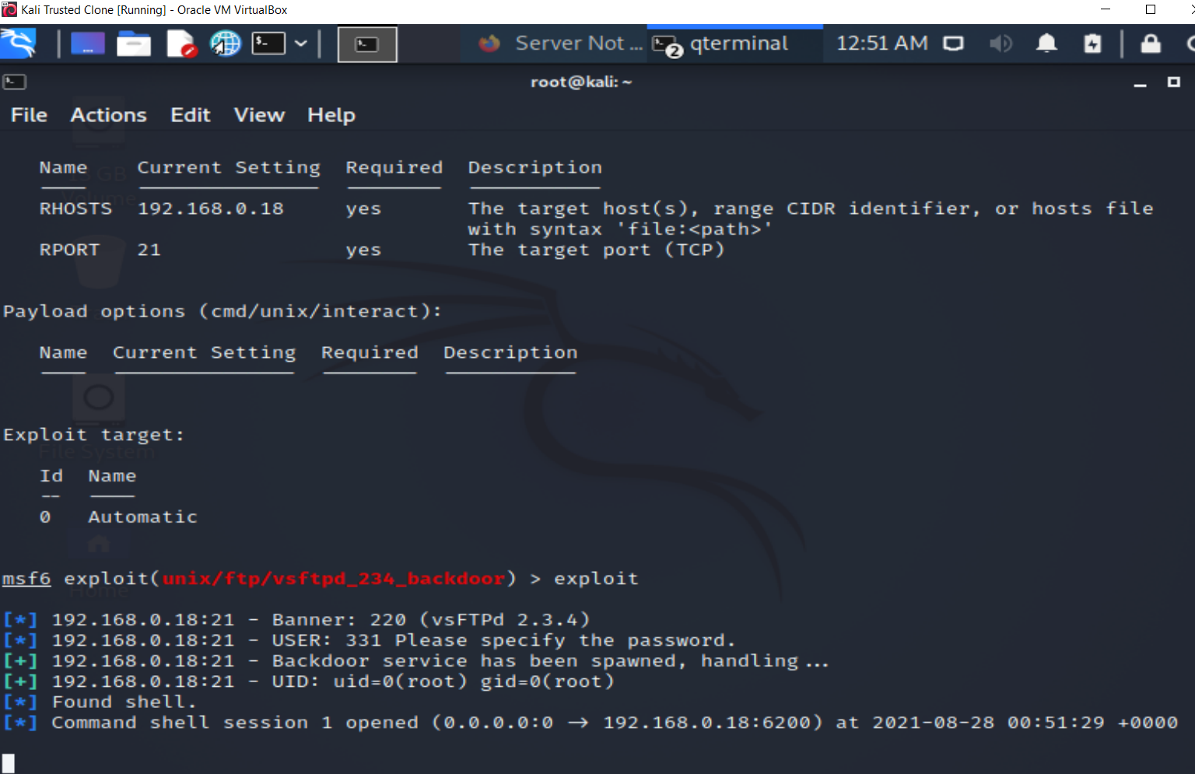
PROJECT C TASK 4 EXPLOIT VULNERABILITIES ON PRODUCTION SERVER
VSFTPD EXPLOIT WITH ROOT ACCESS

Slide 9
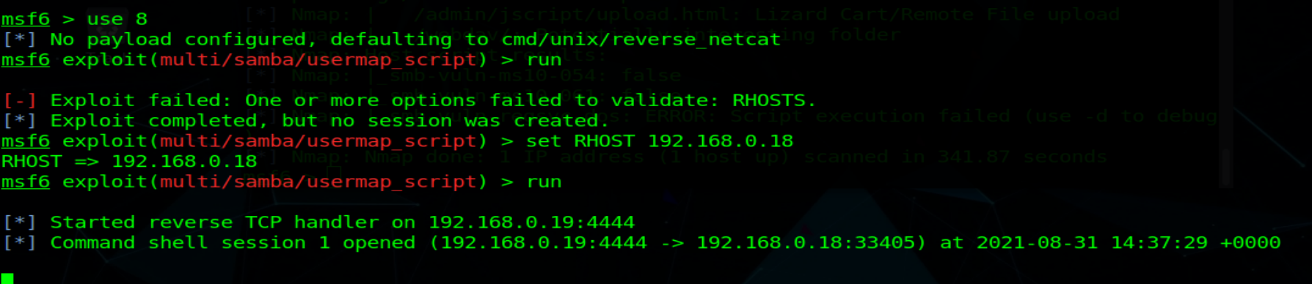
PROJECT C TASK 4 EXPLOIT VULNERABILITIES ON PRODUCTION SERVER
SAMBA USERMAP SCRIPT EXPLOIT WITH REVERSE TCP HANDLER

Slide 10
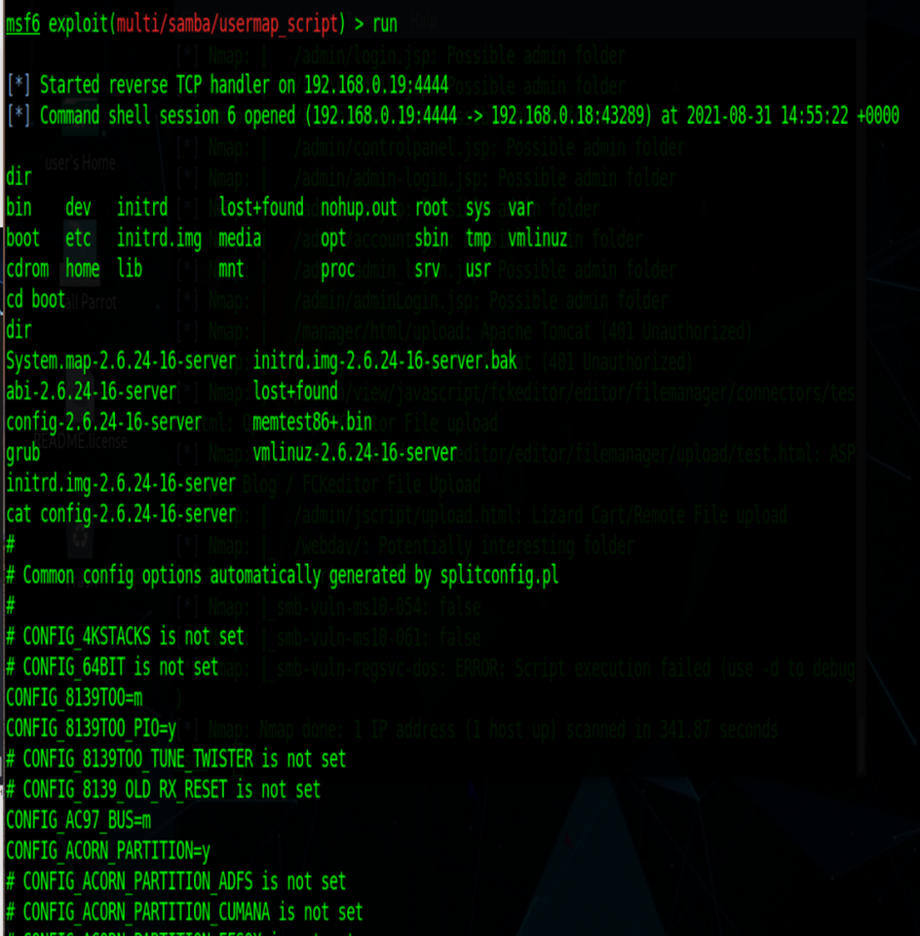
PROJECT C TASK 4 EXPLOIT VULNERABILITIES ON PRODUCTION SERVER

Slide 11
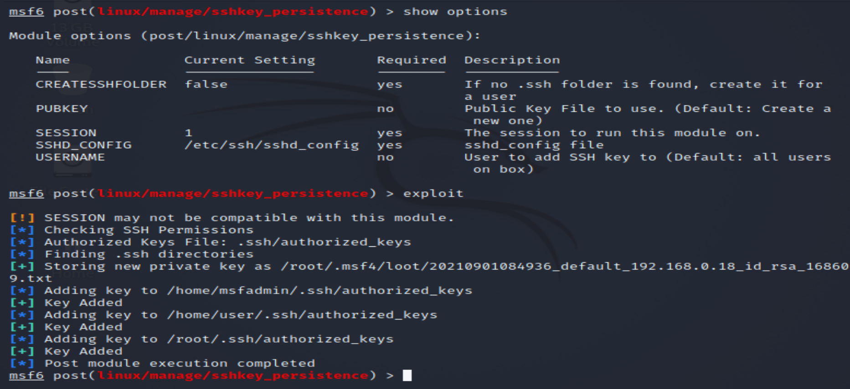
PROJECT C TASK 4 EXPLOIT VULNERABILITIES ON PRODUCTION SERVER
SSH PERSISTENCE EXPLOIT

Slide 12
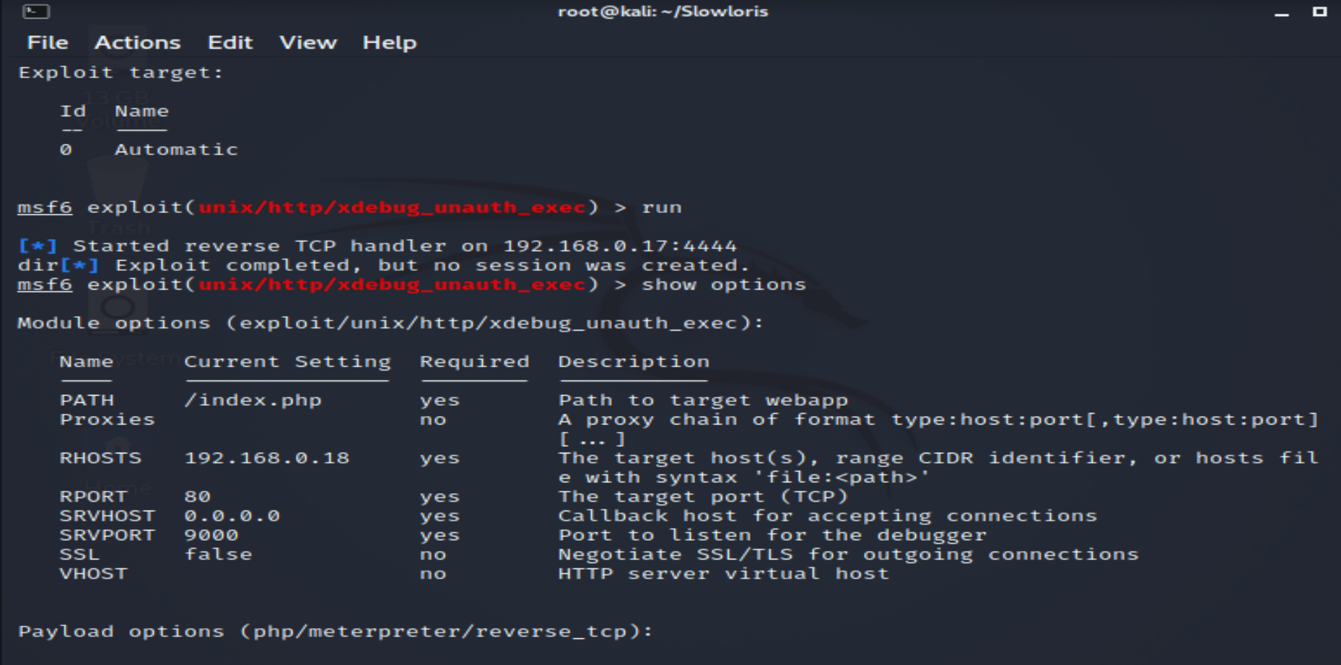
ATTEMPTED EXPLOITS PRODUCTION SERVER

Slide 13
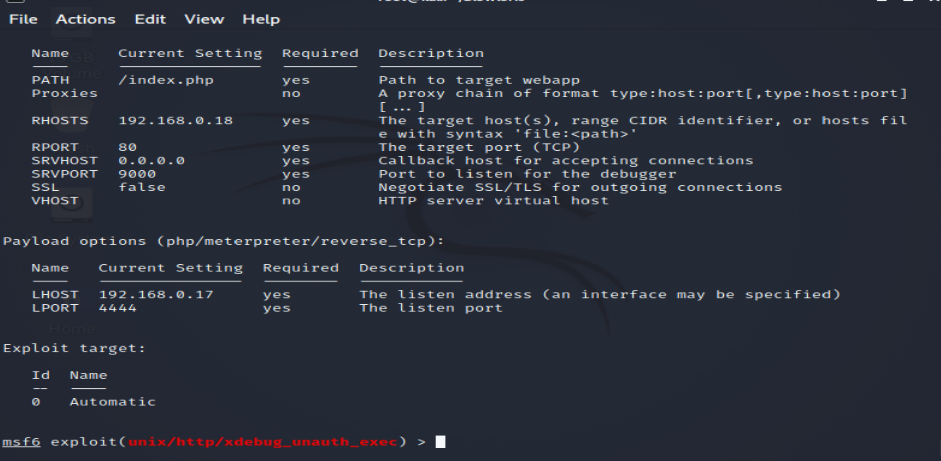
ATTEMPTED EXPLOITS PRODUCTION SERVER

Slide 14
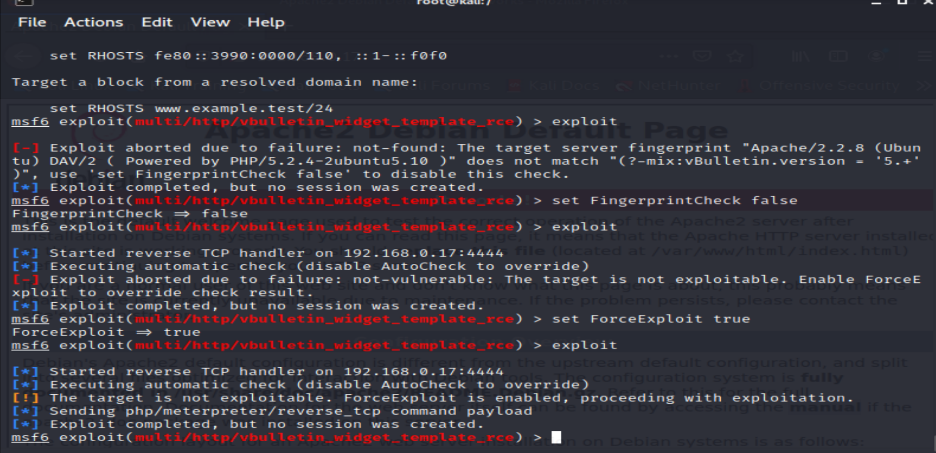
ATTEMPTED EXPLOITS PRODUCTION SERVER

Slide 15
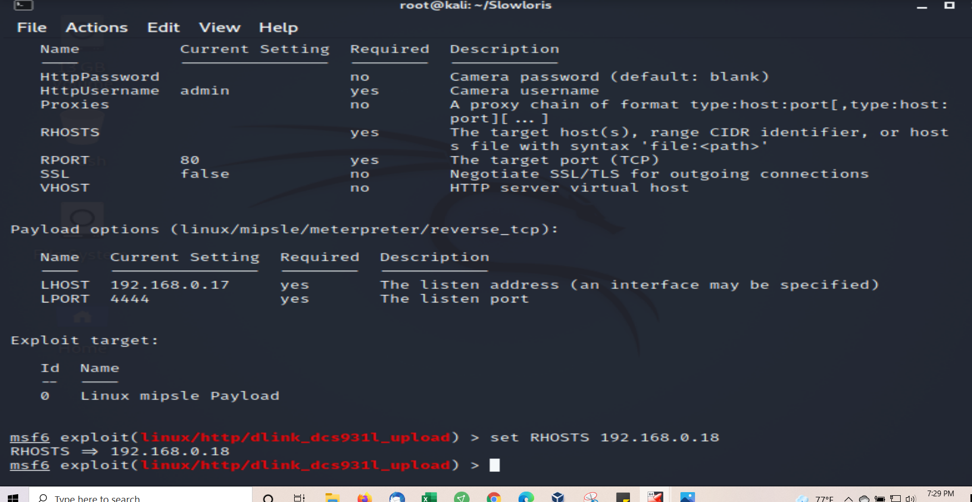
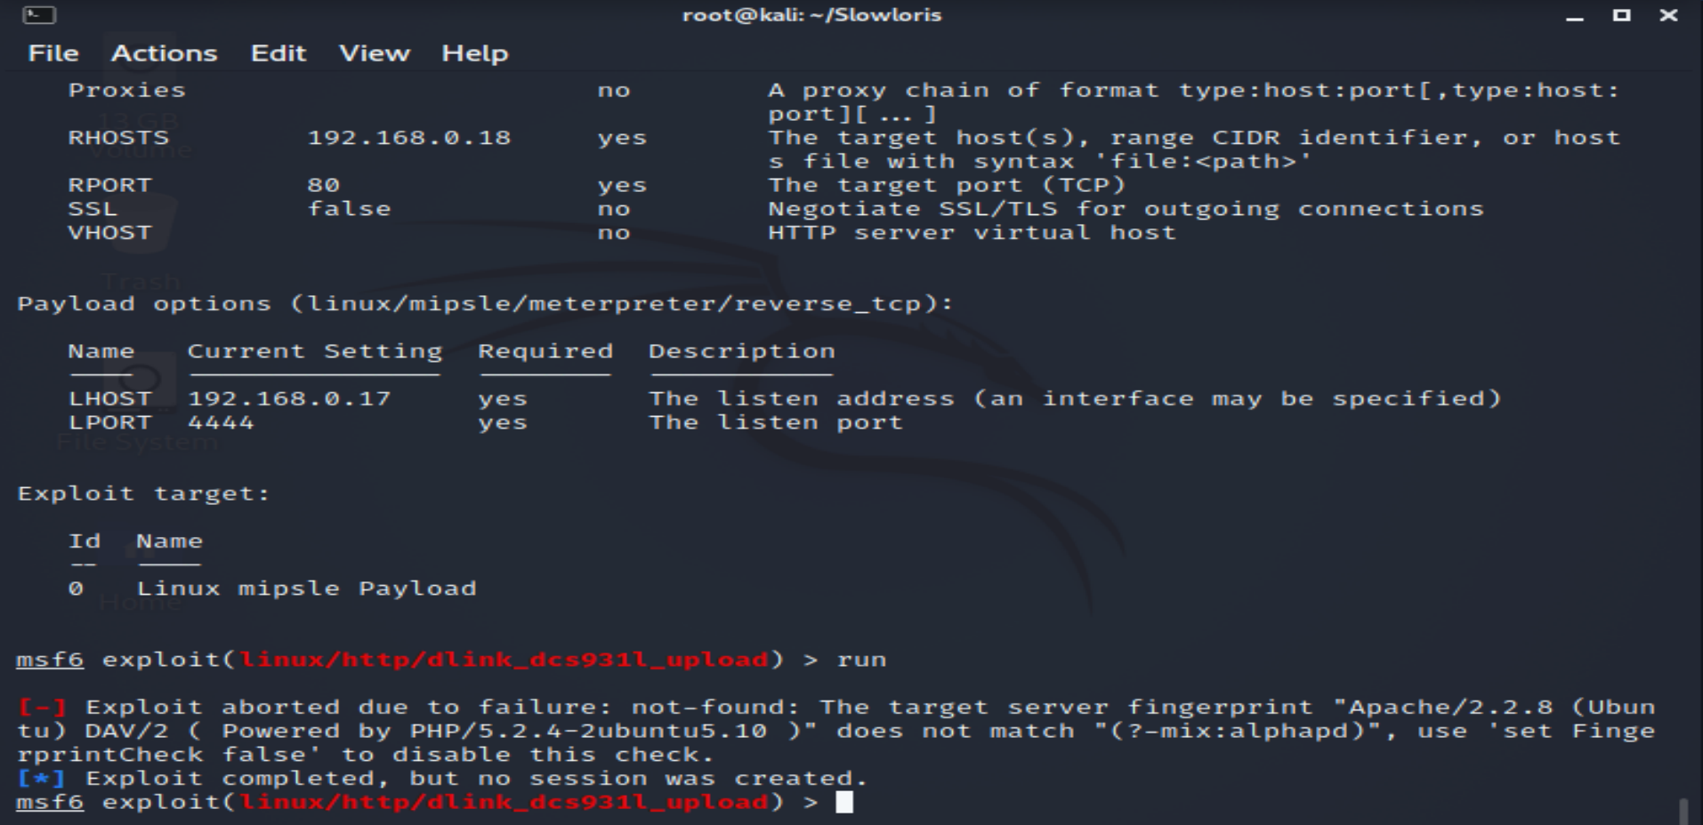
ATTEMPTED EXPLOITS

Slide 16
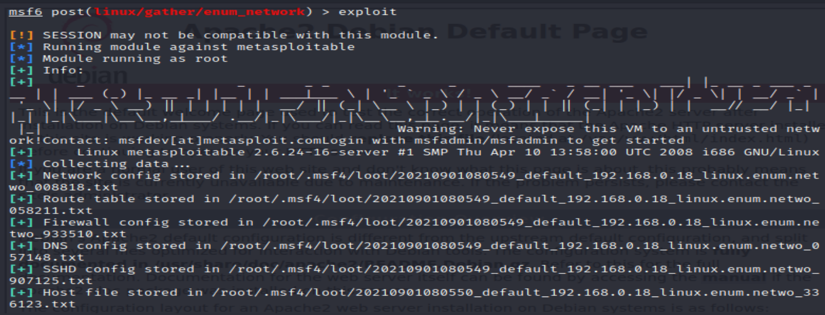
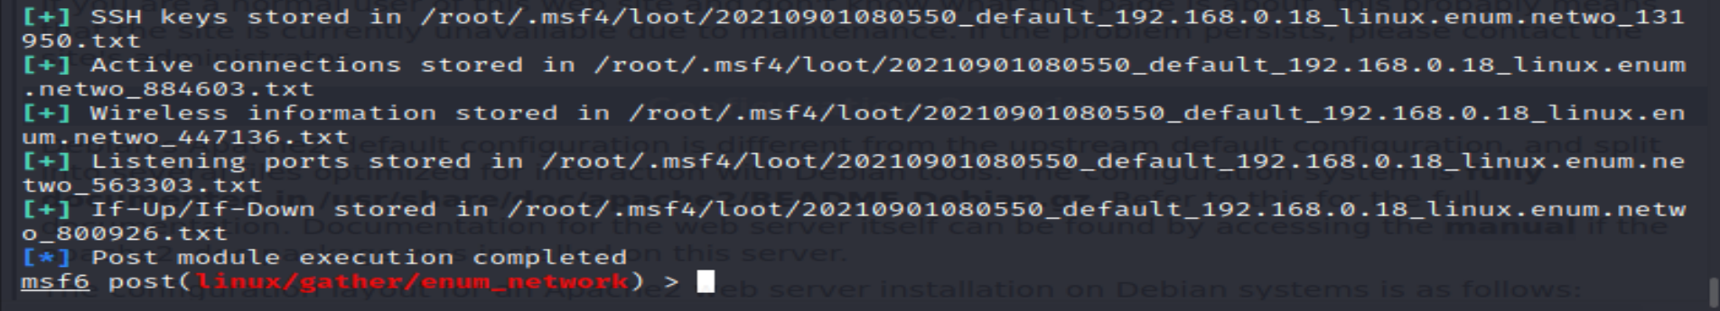
ATTEMPTED EXPLOITS – PASSWORD CRACK PRODUCTION SERVER

Slide 17
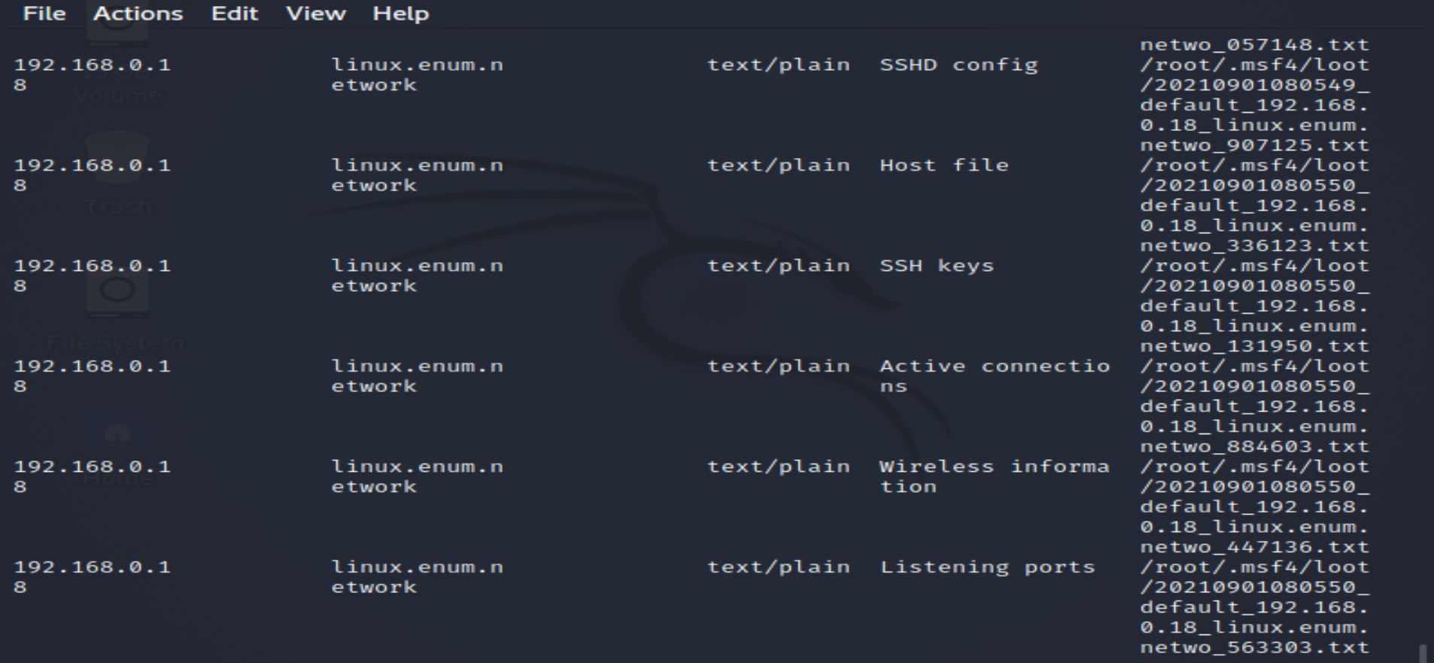
PROJECT C TASK 4 EXPLOIT VULNERABILITIES ON PRODUCTION SERVER
SSH EXPLOIT LOOT

Slide 18
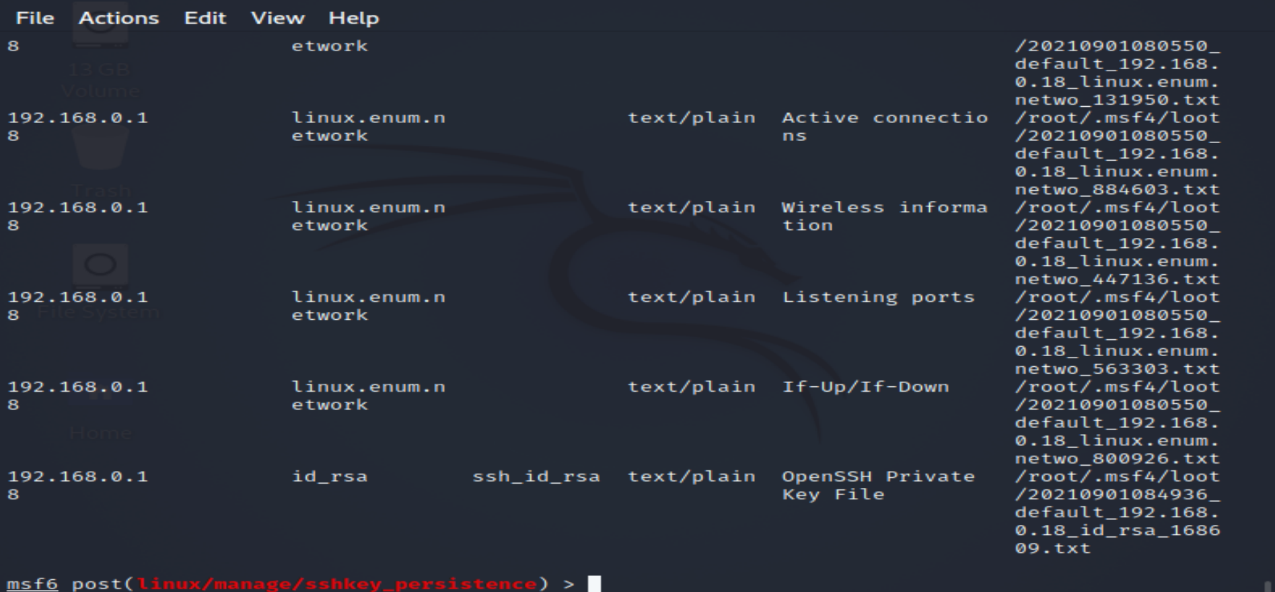
PROJECT C TASK 4 EXPLOIT VULNERABILITIES ON PRODUCTION SERVER
SSH EXPLOIT LOOT

Slide 19
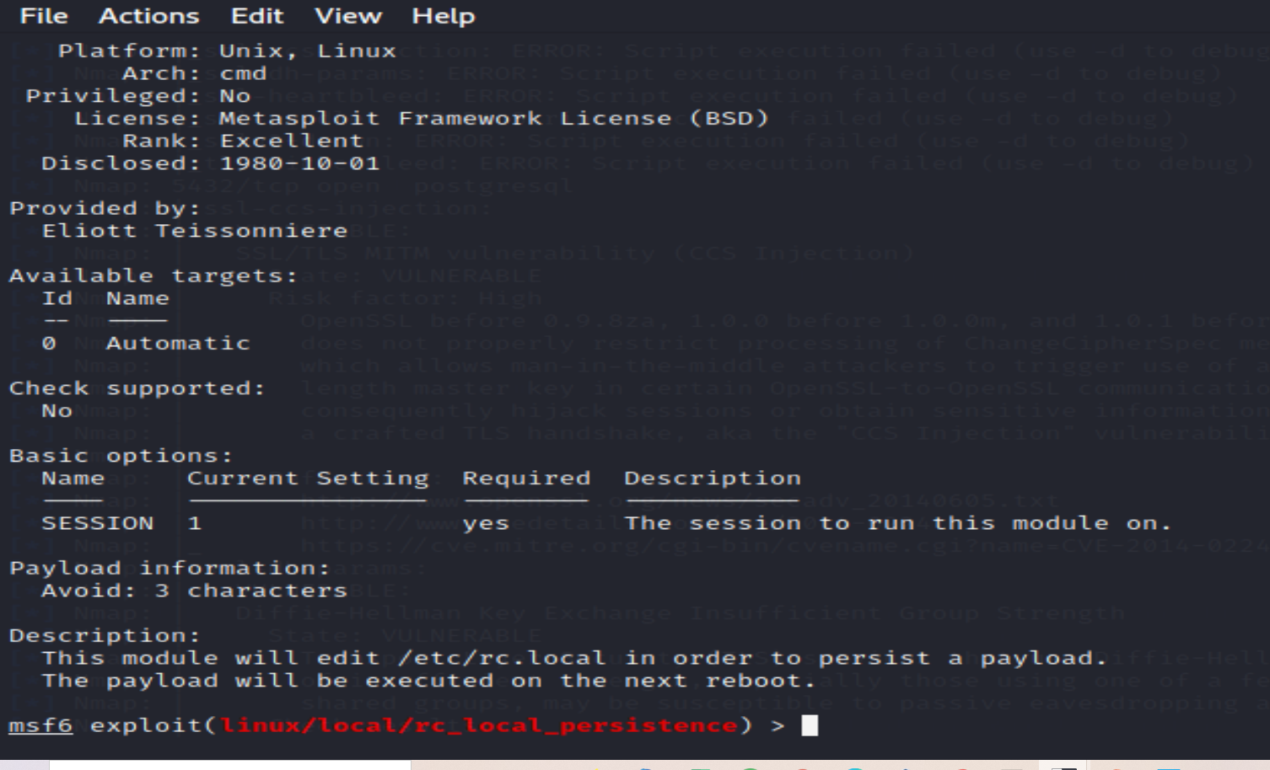
PROJECT C TASK 5 EXPLOIT VULNERABILITIES ON WEB SERVER

Slide 20
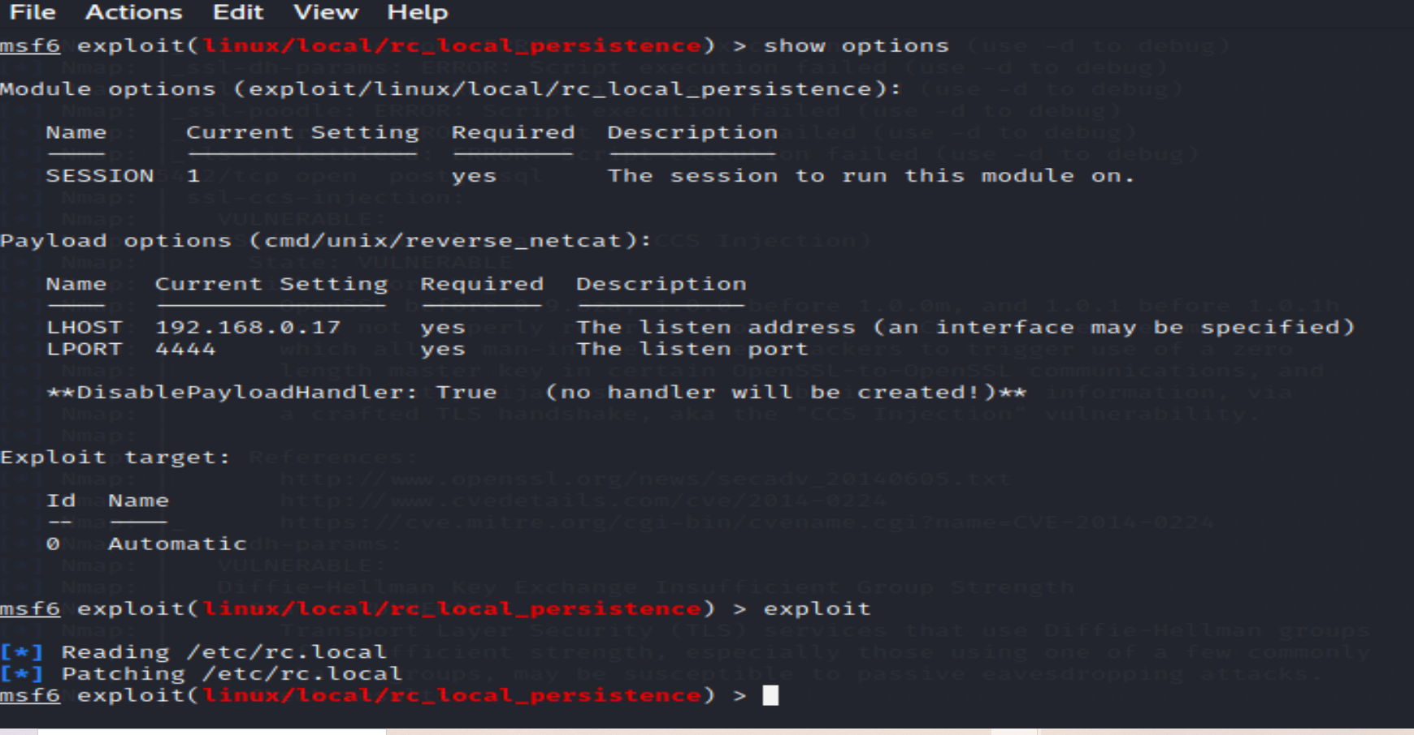
PROJECT C TASK 5 EXPLOIT VULNERABILITIES ON WEB SERVER
Inserts persistence payload that will launch on next reboot of machine

Slide 21
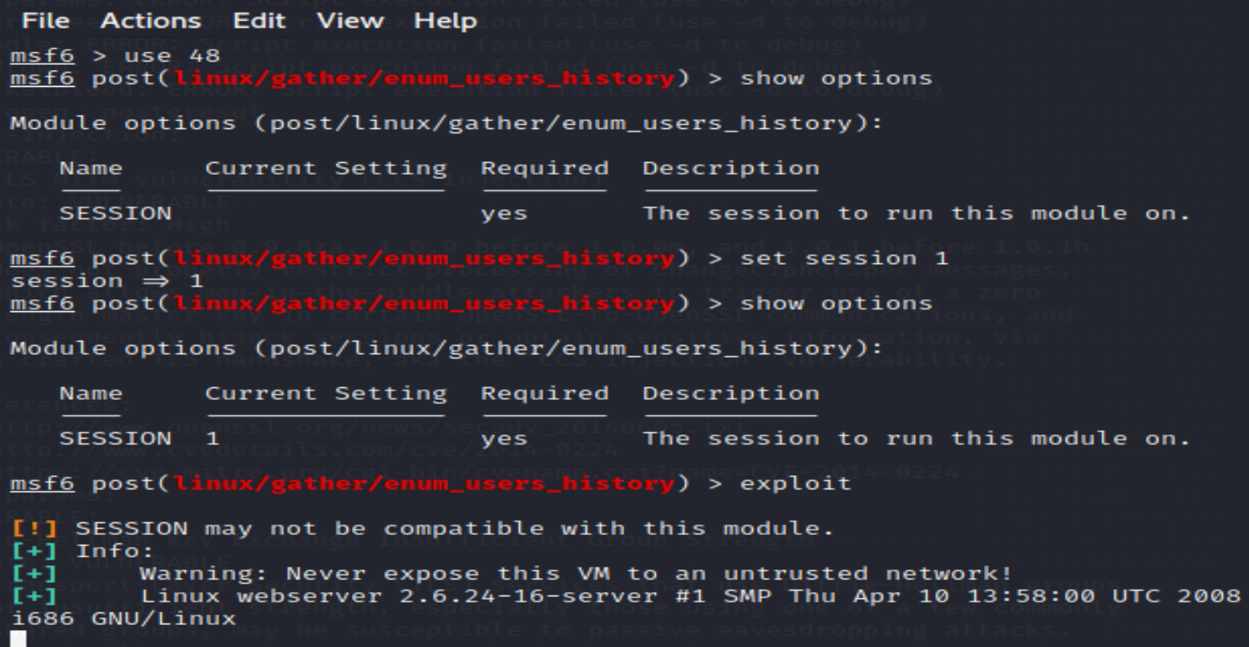
PROJECT C TASK 5 EXPLOIT VULNERABILITIES ON WEB SERVER SUDO USERS LIST

Slide 22
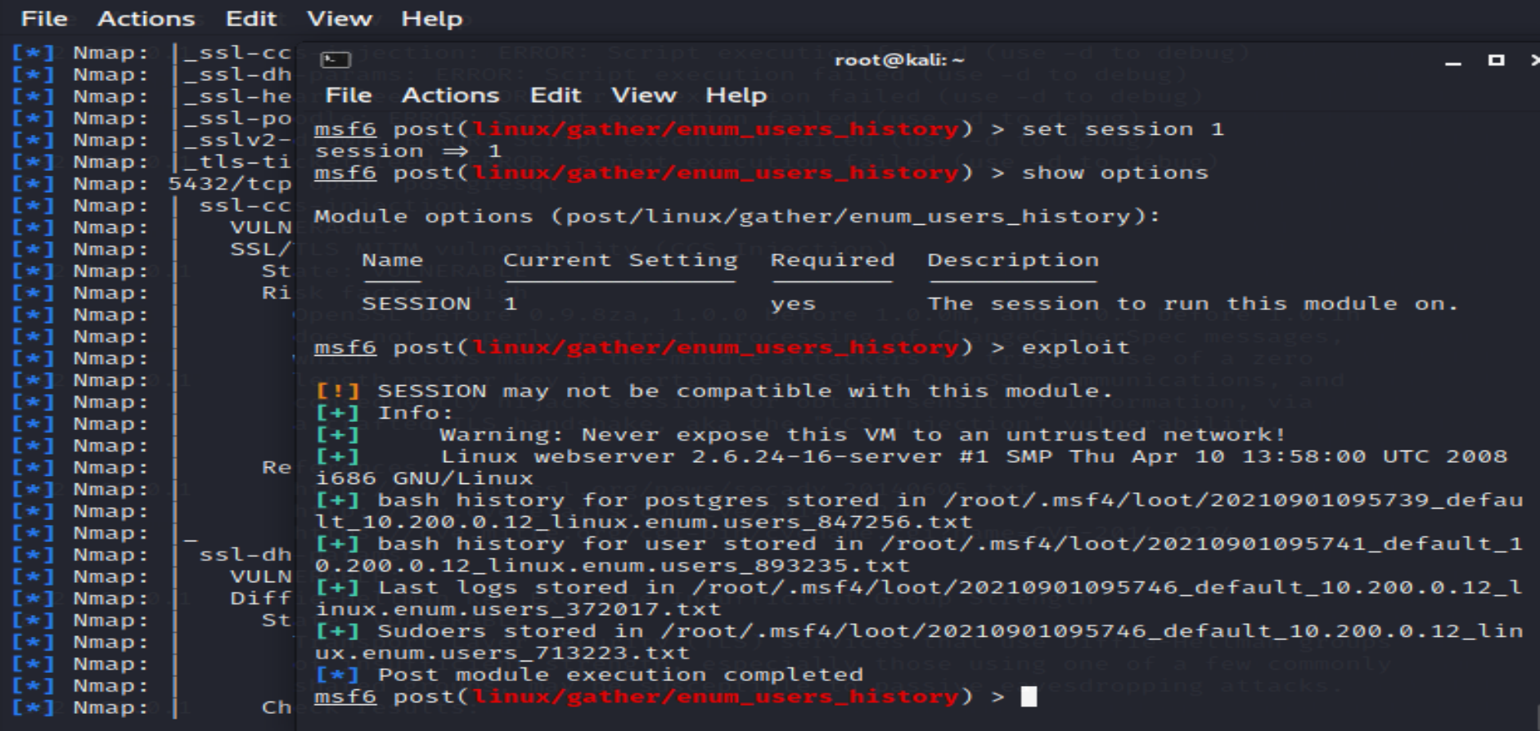
PROJECT C TASK 5 EXPLOIT VULNERABILITIES ON WEB SERVER SUDO USERS LIST

Slide 23
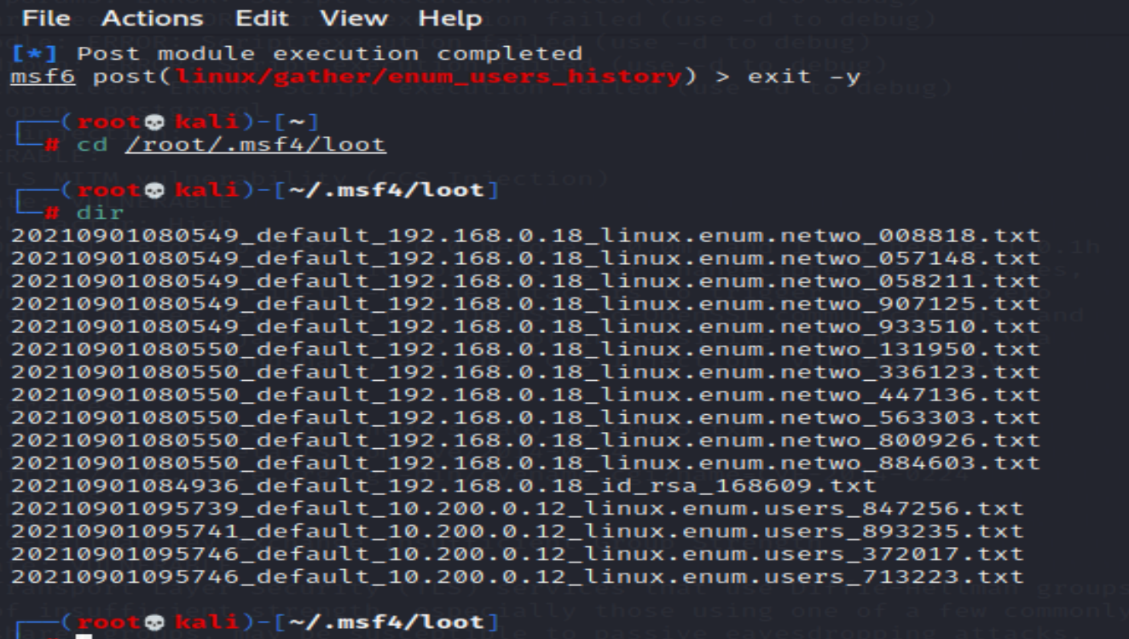
PROJECT C TASK 5 EXPLOIT VULNERABILITIES ON WEB SERVER SUDO USERS LIST

Slide 24
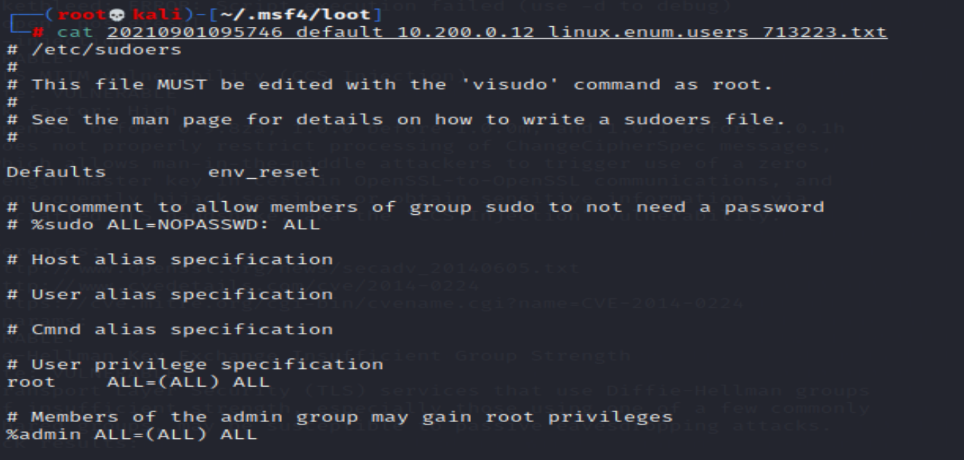
PROJECT C TASK 5 EXPLOIT VULNERABILITIES ON WEB SERVER SUDO USERS LIST

Slide 25
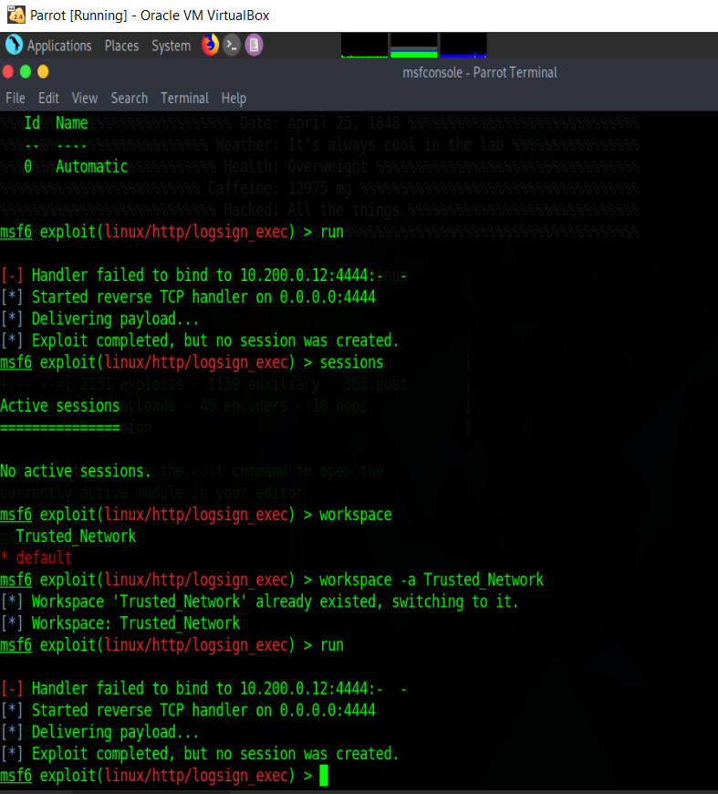
ATTEMPTED EXPLOITS WEB SERVER

Slide 26
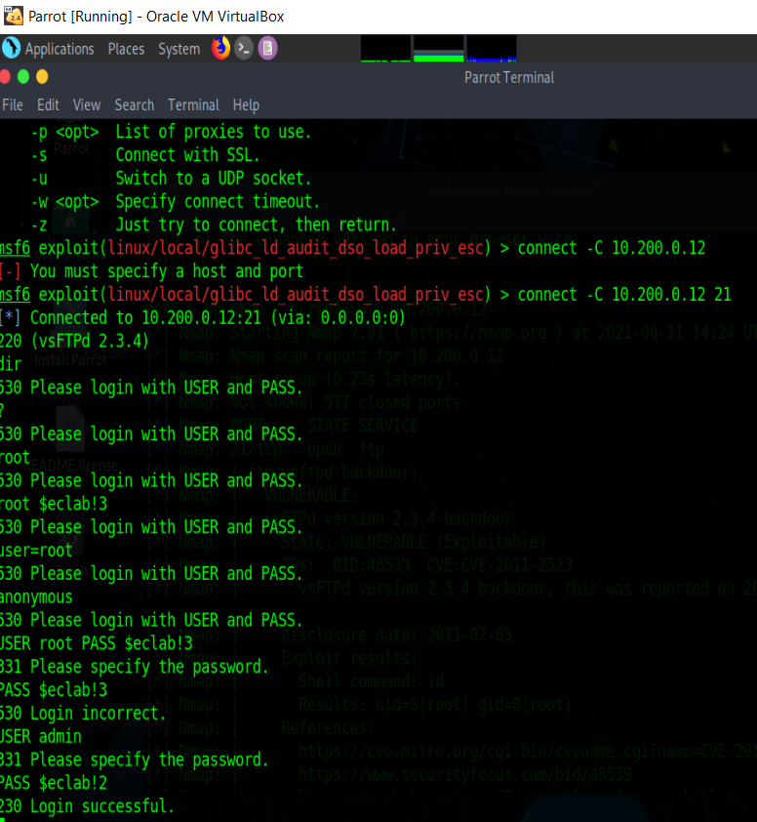
ATTEMPTED EXPLOITS WEB SERVER

Slide 27
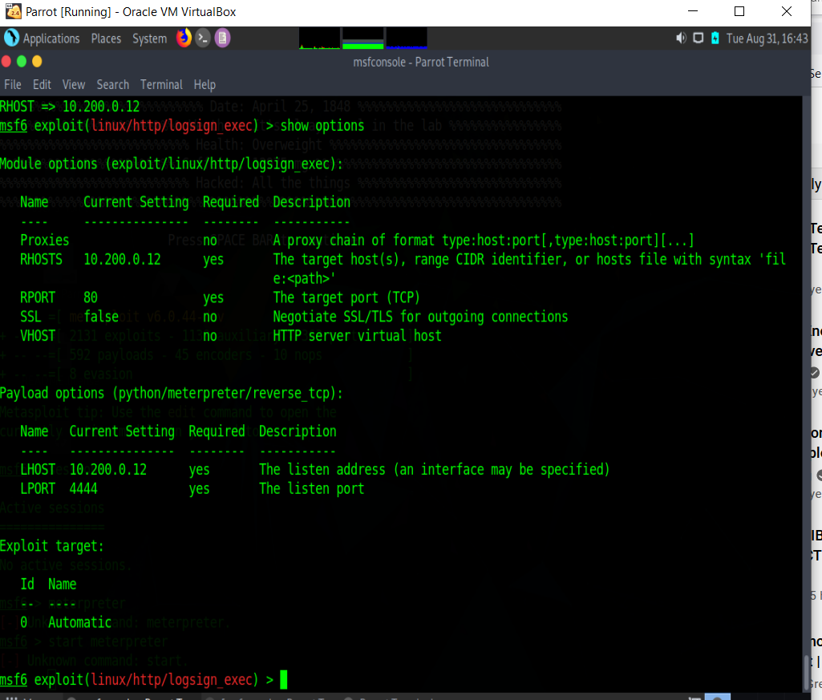
ATTEMPTED EXPLOITS WEB SERVER

Slide 28
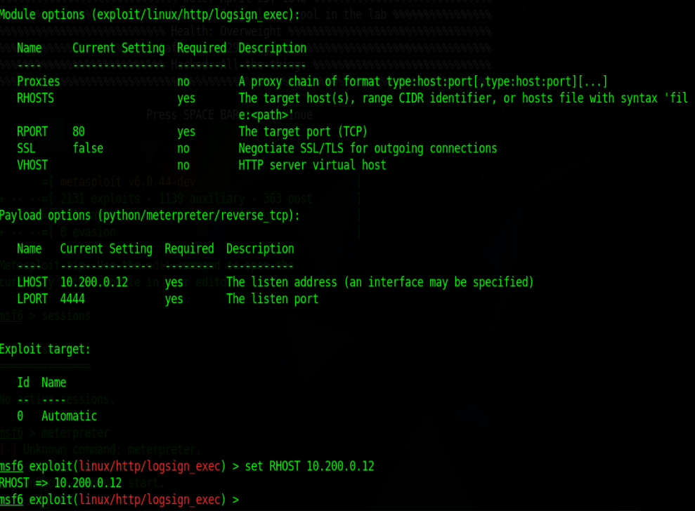
ATTEMPTED EXPLOITS WEB SERVER

Slide 29
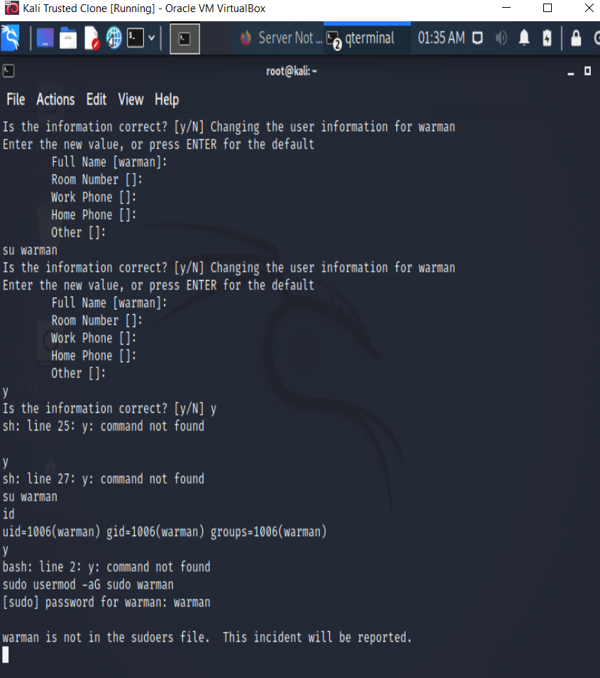
PROJECT C TASK 6 – INITIAL PROBLEM

Slide 30
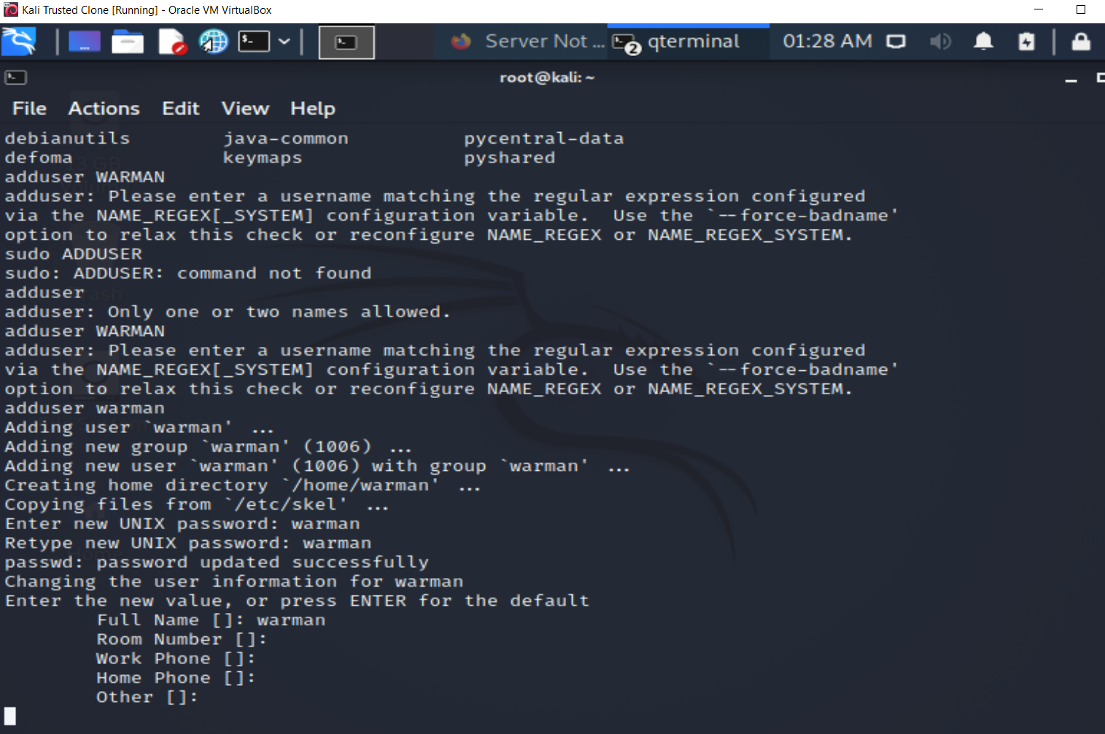
PROJECT C TASK 6 ADD ACCOUNT WITH ROOT PERMISSION

Slide 31
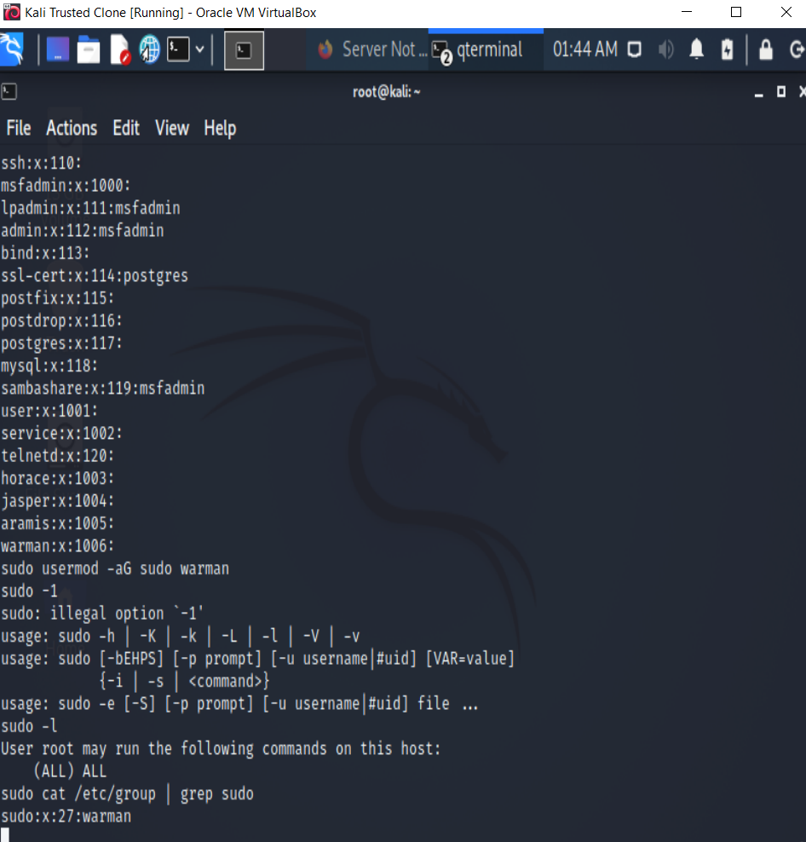
PROJECT C TASK 6 ADD ACCOUNT WITH ROOT PERMISSION

Slide 32
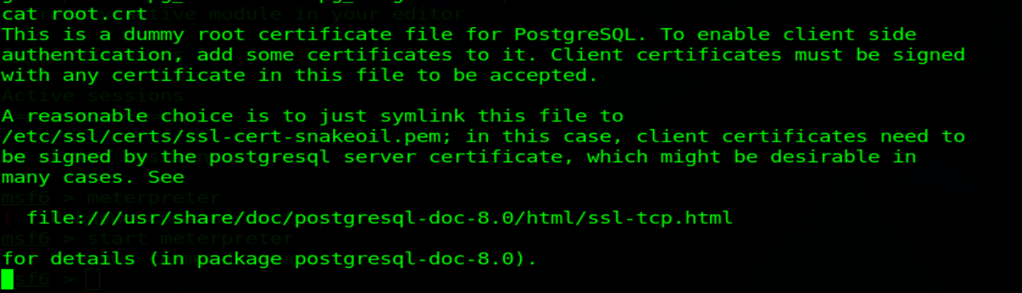
PROJECT C TASK 7 INTERESTING FILES FAKE ROOT CERT

Slide 33
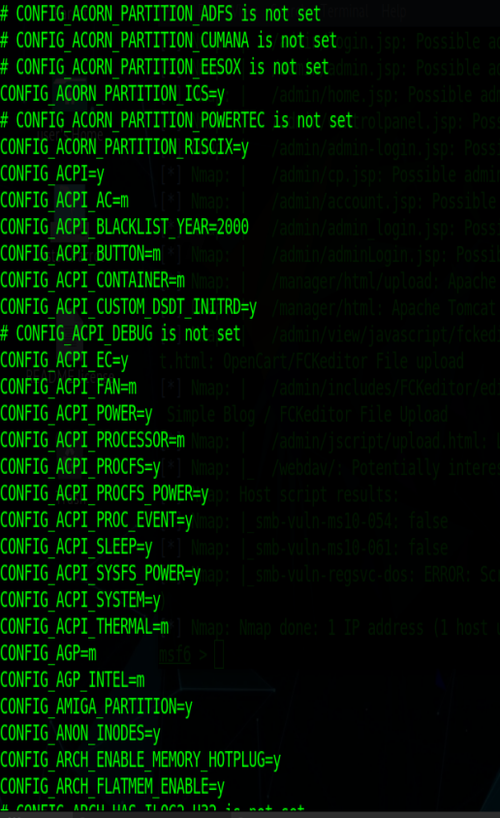
PROJECT C TASK 7 INTERESTING FILES

Slide 34
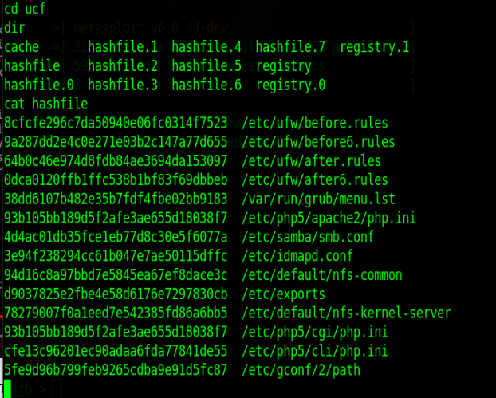
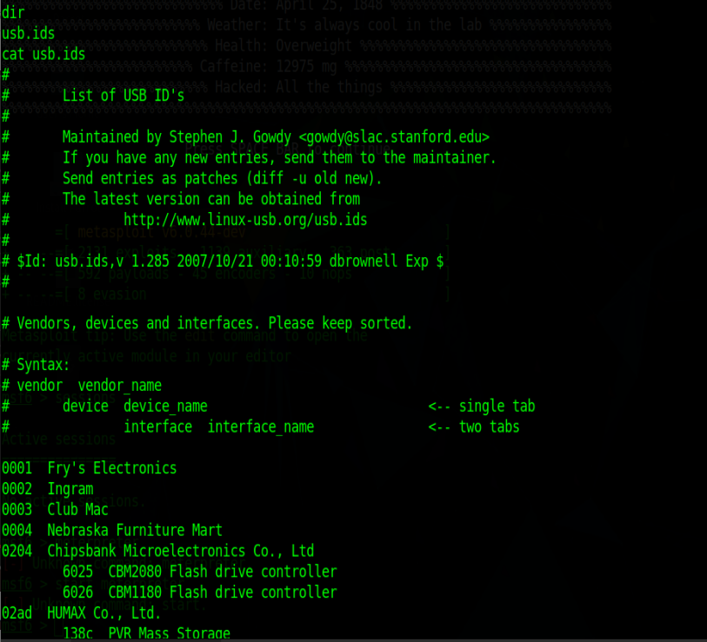
PROJECT C TASK 7 INTERESTING FILES ON WEB SERVER

Slide 35
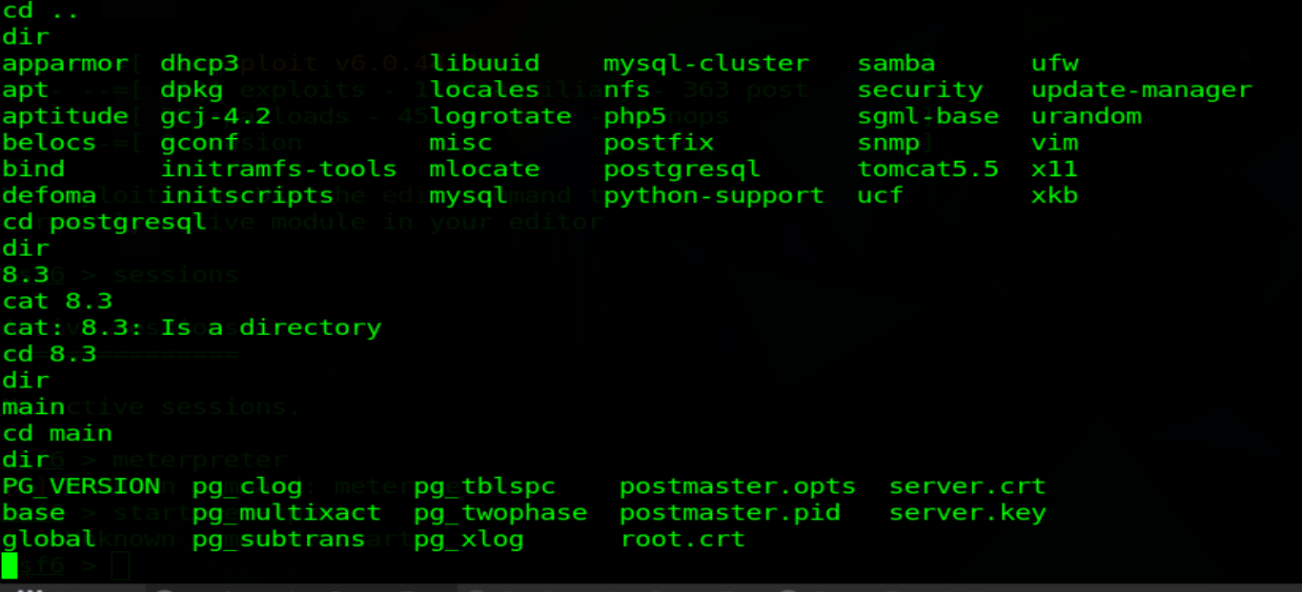
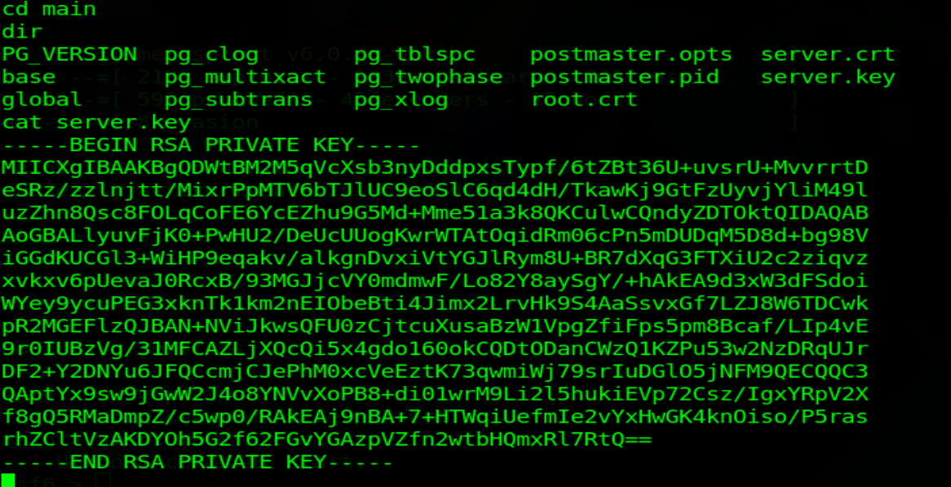
PROJECT C TASK 7 INTERESTING FILES ON WEB SERVER

